Slide 1
Communism in China

Slide 2
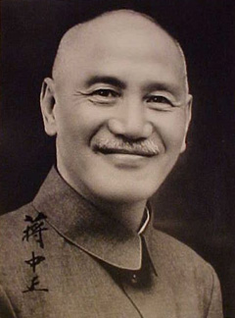
COMMUNIST RISE TO POWER
JIANG JIESHI (CHIANG KAI-SHEK) TAKES OVER NATIONALIST PARTY (GUOMINDANG) 1920’s
Capitalist economic party supported by the US
Dislikes Communist party of China

Slide 3
COMMUNIST RISE TO POWER
Shanghai police
Nationalist soldier
Communist party members

Slide 4
The previous picture was taken at what time of day (approximately)?
What are the police doing about the execution?
Because of this persecution by the Nationalists, the Communists fled the Nationalist forces in 1934 in a retreat known as The Long March

Slide 5
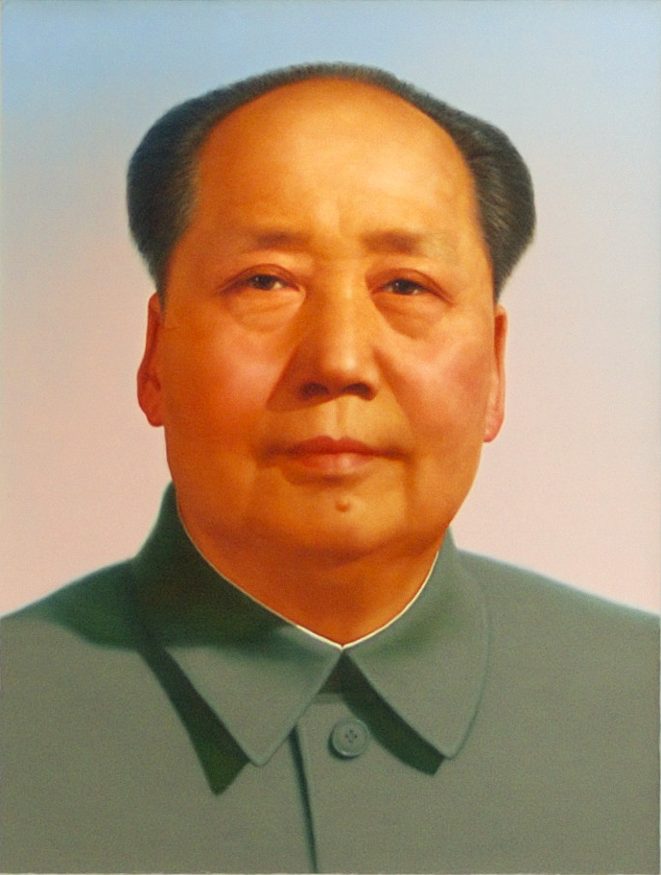
COMMUNIST RISE TO POWER
Mao Zedong, leader of the Chinese Communist Party
Mao pronounced as ‘cow’

Slide 6
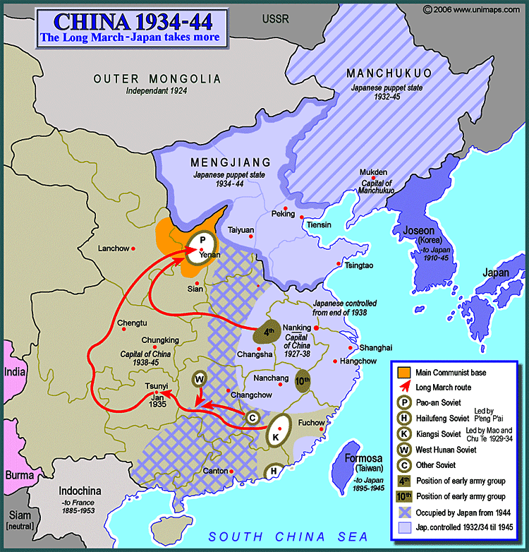
COMMUNIST RISE TO POWER
Mao left from the letter K and joined with the other lettered Soviets in China
They fled to “P”., going 6,000 miles in one year.
Look at the key. Why would that be a good place flee to during this time period?

Slide 7
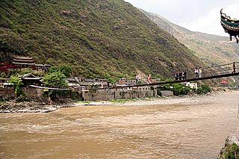
COMMUNIST RISE TO POWER
Ludig Bridge Crossing
Legend has it that the Nationalist Army removed the planks from the top of the chains and that Communists clung to the chains going hand over hand to rebuild the bridge while being fired upon by Nationalists

Slide 8
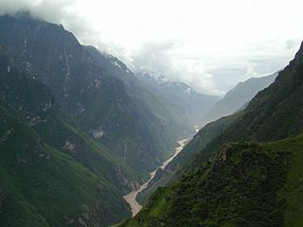
COMMUNIST RISE TO POWER
Tiger Leaping Gorge
Nationalist Army destroyed all of the boats in the region and the Communists went up river and constructed a bridge across this gorge.

Slide 9
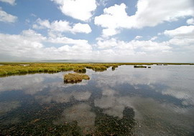
COMMUNIST RISE TO POWER
Songpan Marshes
There was no food here so many people starved to death crossing this marsh.
The mud was also poisonous so legs and feet developed bad infections.
Of the 10,000 that entered this 400 km (250 mile) marsh, only 7,000 made it through.

Slide 10
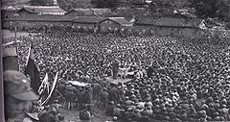
COMMUNIST RISE TO POWER
Of the roughly 100,000 people who started the Long March, only 10,000 survived.
They walked in one year the same distance that it would take to walk from NY to California and back to NY!

Slide 11
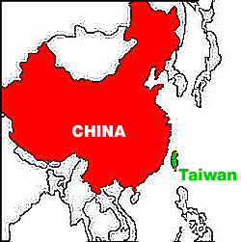
COMMUNIST RISE TO POWER
During WWII, the Nationalists and the Communists stopped fighting each other and joined together to fight the Japanese.
As soon as the war was over, the Civil War started again until the Communists drove the Nationalists and Chiang Kai-Shek and his followers to the nation of Taiwan

